Slide 1
A Journey in Systems Science and System Dynamics – Together with Students
Yaman Barlas
Dept. of Industrial Engineering
SESDYN Lab. http://sesdyn.ie.boun.edu.tr/
Boğaziçi University İstanbul, Türkiye

Slide 2
I- An Overview of the Journey
Middle East Technical University, B.Sc. in Industrial Engineering, Ankara (early 1970’s)
Prof. Bedir Aydemir’s ‘Systems Science’ Course
Ohio University, M.S. in Industrial and Systems Engineering, Athens, Ohio (late 1970’s)
A Couple of Systems Science and Systems Engineering courses
Georgia Tech, PhD in Industrial & Systems Engineering, Atlanta, Georgia (early 1980’s)
Focus on ‘Systems’ and specifically on ‘System Dynamics’. Supervised by Willard R. Fey (one of the first three ‘founding assistants’ of JW Forrester for Industrial Dynamics project at MIT, together with Jack Pugh and Ed Roberts).

Slide 3
I- An Overview of the Journey
Miami University, Faculty Member, Systems Analysis Dept, Oxford, Ohio (1985-1992)
Simulation, various modeling courses, and system dynamics
Boğaziçi University, Faculty, Industrial Engineering Dept, Istanbul, (1993 - present)
Simulation, two systems science and two system dynamics courses...
SESYDN Group/Lab and research in ‘systems’ and SD...
Brief sabbatical visits at:
University of Bergen; MIT Sloan School; Radboud University, Nijmegen; National University of Ireland, Galway; New York University, School of Global Public Health.
Notes:
A 35-40 years journey, in 35-40 mins. A minute per year!☺

Slide 4
II- Teaching: Learning ‘Systems’ and SD Together with Students
Main graduate/senior undergrad course in System Dynamics (IE 550)
An undergrad course on ‘Systems Science’ and System Dynamics (IE 350)
A grad course on analytical aspects of dynamical systems modeling and analysis (IE 533)
A graduate course on advanced system dynamics modeling and analysis (IE 602)
And some other systems-related courses on agent-based modeling and simulation

Slide 5
Outline of Dynamics of Socio-Economic Systems (IE 550)
Notes:
Note: This is one of the very rare model-building courses taught in our department or in any IE. Great majority courses are about ‘analysis/optimization of given models’. Something unique to SD, as I will re-visit...

Slide 6
Outline of Systems Science and Engineering (IE 350)

Slide 7
III- Research: Learning with System Dynamics - Together with Students
Main research areas in SESDYN:
Misc. socio-economic problems
Environmental & ecological problems -> sustainability
Medical & healthcare problems (focus in the last 15 yrs)
Methodology research: (mainly on model credibility & testing)
Rationale behind application and meth. focus areas:
Medical & health problems
Model credibility and testing methods and tools
Student quality and contribution most essential
Notes:
1- These are ‘natural’ dynamic feedback problems, AND people are truly concerned about.
2- Model testing and credibility will be more and more important in the future with modeling software proliferation

Slide 8
Award Winning Student Research (Undergrad and Grad)
A Dynamic Simulator for the Management of Disorders of the Body Water Homeostasis (Karanfil 2006; with Barlas, 2008). Dana Meadows Award 2006.
Modeling the Dynamics of Avian Influenza Epidemics and Possible Pandemics (Eskici and Türkgülü 2007). Best Poster Award, ISDC 2007
A simulation model for blood cholesterol dynamics and related disorders (Demirezen and Barlas, 2009). Lupina award.
Dynamic Modeling of Peritoneal Dialysis and Its Implementations in Children with Chronic Kidney Failure (Gökalp, Başar and Tekin 2012). National YAEM 2012 award.
Interactive Dynamic Modelling for the Passenger Flow Bottleneck and Security Check-point Management in Atatürk Airport (Çakacıaslan, Sağlık, Seke and Uğur 2013). TUBITAK National Student Project Award.

Slide 9
Award Winning Student Research (Undergrad and Grad)
Modeling The Dynamics Of Thyroid Hormones And Related Disorders (Şeker, Barlas and Alagöl, 2011). Lupina award.
Behavior Analysis and Testing Software (BATS) (Sücüllü and Yücel 2014). Dana Meadows Award.
Modeling the Biological Mechanisms that Determine the Dynamics of Stress Response of the Human Body (Aktaş and Barlas, 2018). Dana Meadows award and Lupina award.
Modeling the Dynamics of Vicious Cycles Involved in Heart-Respiratory Failure (Çömez, S. 2020). Lupina award.
Modeling the Pharmacodynamics of rHuEPO, a Blood Doping Drug (Şentürk, Barlas and Yaşarcan, 2020). Dana Meadows award.
Modeling the dynamics of Covid 19 and alternative policies in Türkiye (Bayazıt and Karamalak, 2021). ). Lupina award –honorable mention; and National YAEM 2021 award.
Notes:
On students success: Not just to thank and appreciate my students. Also to motivate all students out there; that great work is possible and rewarding –although SD is not an easy field.

Slide 10
‘Real Life’ Applications
We have had several ‘real-life projects’ (Some of our medical and healthcare modeling; National university entrance exam dynamics; University management problem; Regional irrigation project modeling, Strategic insurance management, Mobile service competition management... Various professional training activities...)
Must underline one activity in which I played no direct role: A few years ago a voluntary ‘citizen movement’ started: ‘ST and SD in K-12 education’. In the past 10 years, these citizen champions first learned ST and SD, then started to organize workshops to train (or have me train☺) K-12 teachers. In the process, they also initiated national ‘Systems Thinking Society’. Today, we have hundreds of K-12 teachers who participate in these activities. They receive no promotion, no salary increase as a result. It is pure curiosity and will to do something good. There is now a very rich website, numerous models to play with, newsletters, meetings, and books!.. They occasionally present their work in ISDC. But it is much much more then what is presented. It should be a source of inspiration for us all.
Notes:
Diana Fisher and Water Foundation know about this ST/ST in education group

Slide 11
IV- On Model Credibility/Quality (Validity) and Testing
Definition (for causal-descriptive policy models): Is my model an acceptable (good enough, adequate...) simplified representation of real-life relations, with respect to the dynamic problem of concern?
Note that the adjective is not ‘correct’ or ‘accurate’ or ‘true’...
Also note that the definition becomes incomplete (or trivially invalid) unless we qualify with ‘problem of concern’.
The totality of relations (in real system or model) is called the structure (of real system or model).
Finally note that this definition holds for causal-descriptive policy models. For forecasting models, the definition of model credibility becomes much simpler: The model is adequate, if its output is statistically close enough to real data.

Slide 12
Two Fundamentally Different Types Of Models
Statistical Forecasting models (black box)
Purpose: Assisting decisions by providing forecasts
Nature: Short term ( a few) point forecasts
Procedure: Curve-fitting to given data (Regression, time series analysis, ‘some’ econometric models, data science tools…)
Scope: Typically one dependent and many independent variables
Essence of credibility: statistical fit of model output to real data
Descriptive/Causal Policy models (transparent)
Purpose: Assist in policy evaluation, improvement and design
Nature: Long term trajectory (dynamic behavior) projections
Procedure: Causal-descriptive modeling of real processes (Models in natural sciences; simulation, system dynamics, structural equation modeling; and ‘some’ economic models…)
Scope: Typically many inter-dependent variables and a few independents
Essence of credibility: Adequacy of relations in the model (‘structural’)

Slide 13
Being There (Hal Ashby 1979, with Peter Sellers…)
President "Bobby": Mr. Gardner, do you agree with Ben, or do you think that we can stimulate growth through temporary incentives?
[Long pause]
Chance the Gardener: As long as the roots are not severed, all is well. And all will be well in the garden.
President "Bobby": In the garden.
Chance the Gardener: Yes. In the garden, growth has it seasons. First comes spring and summer, but then we have fall and winter. And then we get spring and summer again.
President "Bobby": Spring and summer.
Chance the Gardener: Yes.
President "Bobby": Then fall and winter.
Chance the Gardener: Yes.
Benjamin Rand: I think what our insightful young friend is saying is that we welcome the inevitable seasons of nature, but we're upset by the seasons of our economy.
Chance the Gardener: Yes! There will be growth in the spring!
Benjamin Rand: Hmm!
Chance the Gardener: Hmm!
President "Bobby": Hm. Well, Mr. Gardner, I must admit that is one of the most refreshing and optimistic statements I've heard in a very, very long time.
[Benjamin Rand applauds]
President "Bobby": I admire your good, solid sense. That's precisely what we lack on Capitol Hill.

Slide 14
(a)
Housing
Pressure
Polution
Pressure
(b)
Comparing (a) an exogenous, static, forecasting model of city population with (b) an endogenous, dynamic policy model.

Slide 15
Two aspects of model credibility (For Causal-Descriptive Models)
Structure Credibility
Primary role
(‘Explanation’ in Philosophy of science)
(Validation/evaluation in descriptive modeling fields)
Behavior (output/predictive) Credibility
Role and nature in scientific theory justification
(also related to the ‘problem of induction’)
Ex ante versus ex post prediction
Role in causal-descriptive modeling fields
‘Right behavior for the right reasons’;
Proper ‘resolution’; dynamic ‘patterns’… policy orientation
Suitable statistical tools (like BTS and BATS software…)

Slide 16
Formal Structure Credibility Testing
(Simulation Model Verification)
Direct Structure Tests
Direct comparison of model structures with real ones
All variables, parameters and equations with explainable real meanings
Meaningful units, and unit consistency in each equation
Meaningful/logical outputs under extreme input conditions
Distributed through the entire modeling methodology
Crucial, yet rather qualitative, subjective and informal
Indirect Structure Tests
Extreme conditions and other ‘special’ simulation runs
Crucial, and can also be quantitative and formal
Seems to be the most promising area for model credibility and testing research. (The following few slides…)

Slide 17
Indirect Structure Testing Methods & Software: ISTS, SiS and BATS
ISTS
An algorithm for dynamic pattern recognition and classification (based on ‘hidden markov chains’)
SiS
A software that implements ISTS by communicating with Vensim simulation software
BATS
A user-friendly (‘modern’) software that implements ISTS and also integrates it with BTS (the ‘Behavior Testing Software’)
We will illustrate usages of Indirect testing method of ISTS implemented in BATS

Slide 18
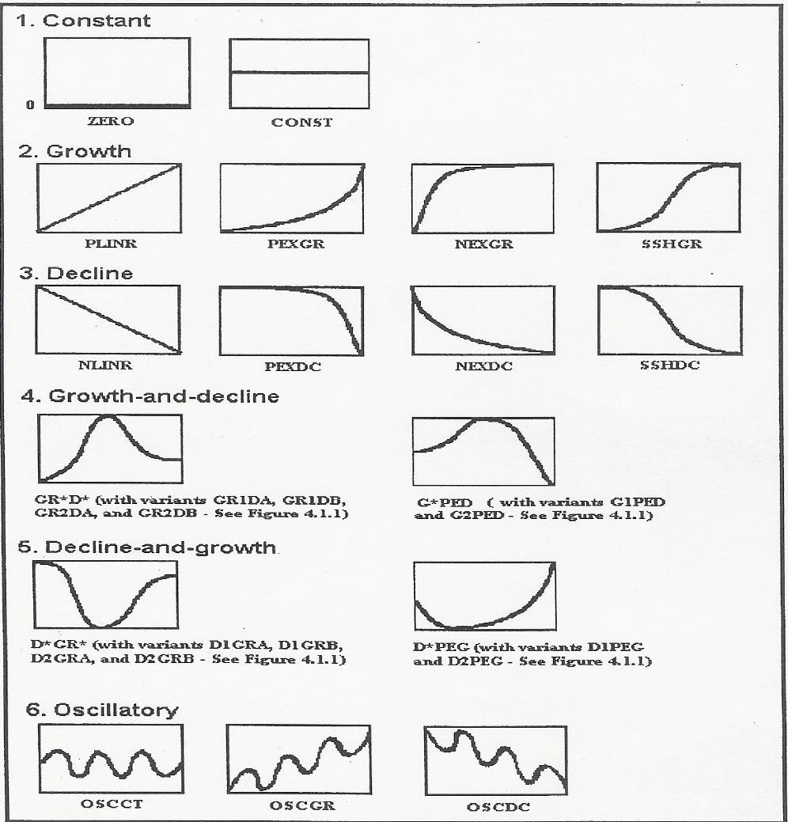
Basic Dynamic Pattern Classes (used by ISTS)

Slide 19
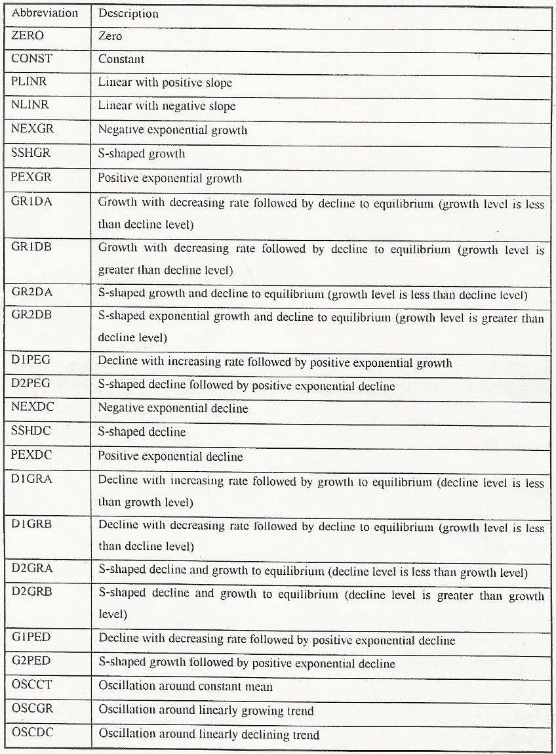
List of dynamic behavior pattern classes

Slide 20
BATS (and SiS) Interfaces
Data-series
Commands
Excel
BATS
Vensim
Export
Simulation results
Control
View
USER
(From Sücüllü 2014)
Notes:
*

Slide 21
Overview of Features of BATS
Data Importing
Load From File
Model Docking Window
Draw
Data Visualization
Plot
Model Analysis
Hypothesis Tester
Behavior Space Classifier
Behavior Class Mapper
Data Analysis
Classify
Trend
Autocorrelation
Autocorrelation Test
Spectral Density
Amplitude Estimation
Crosscorrelation
Summary Stats
Graphical Comparison
Data Preparation
Split
Select
Exponential Smoothing
Moving Average
< Trend >
(From Sücüllü 2014)
Notes:
*
As you can see most of the features under Data Analysis are implementations of the Multi-Step procedure by Barlas for behavior pattern testing.
(Why is it different than the thesis report and software menus? Changed it to make it easier to explain. In the software the menus are arranged according to programming logic; functions that work with data series, functions that work with Vensim models).

Slide 22
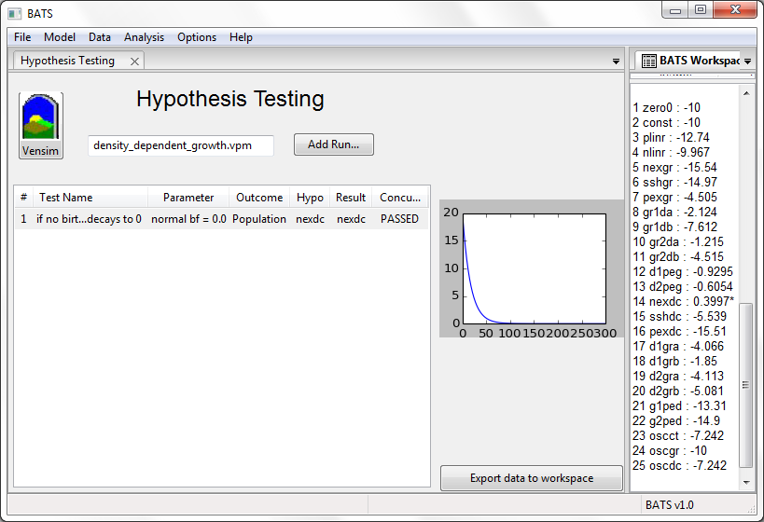
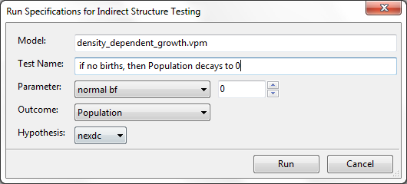
BATS Pattern Hypothesis Tester
Extreme conditions are imposed by parameter values
Model is run and output is obtained
ISTS Algorithm is called
IF hypothesized behavior <-3 FAILED
IF hypothesized behavior >-3 PASSED
IF multiple >-3 INCONCLUSIVE
(From Sücüllü 2014)
Notes:
*

Slide 23
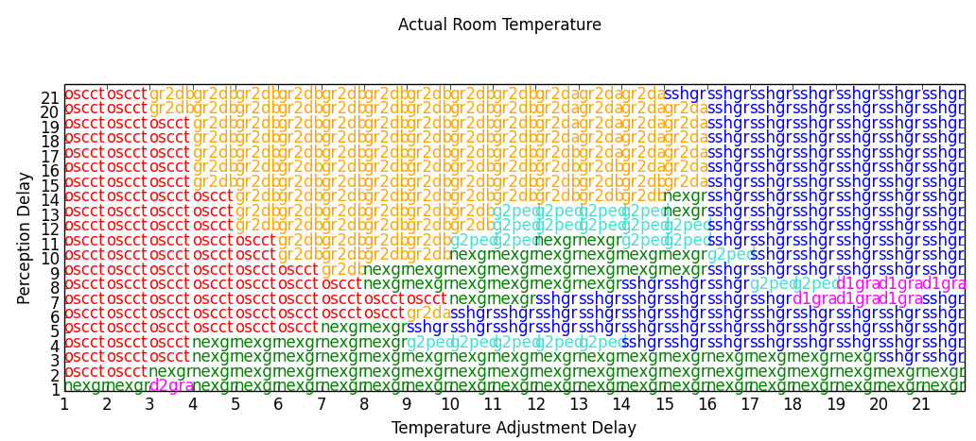

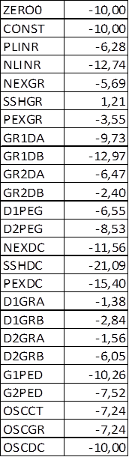
BATS Behavior Space Classifier
Outcome Variable
Parameter 2 Range 2
For each cell, a simulation run is made
Parameter 1 Range 1
Model output is taken from Vensim
The highest value is entered in the Classifier Grid cell
ISTS Algorithm is called
25 likelihoods are obtained
Param1=1
Param2=9
oscct
(From Sücüllü 2014)
Notes:
*

Slide 24
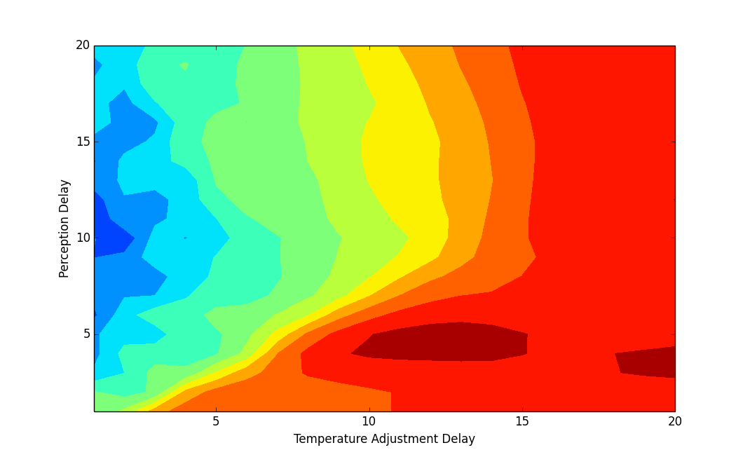
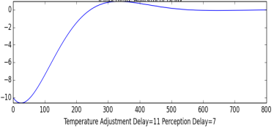
BATS Behavior Class Mapper
Pre-specified class is sshgr
(s-shaped-growth)
For each point, a simulation run is made
Model output is taken from Vensim
The likelihood value for pre-specified class is plotted on the graph
ISTS Algorithm is called
25 likelihoods are obtained
Param1=8
Param2=16
-3.99
(From Sücüllü 2014)
Notes:
*

Slide 25
Usage Modes of (ISTS, SiS, BATS…)
Indirect structure testing
Extreme condition hypothesis testing...
Sensitivity analysis (by behavior pattern space)
Behavior pattern sensitivity with respect to parameter changes
Model calibration
Automated parameter calibration based on input (real) behavior patterns
Policy analysis and design
Policy parameter(s) specification based on desired behavior patterns
Statistical behavior pattern validity testing
Barlas’ Multi-Step Procedure and Graphical Inspection
Notes:
*

Slide 26
Model Quality/Credibility must be ‘built-in’, not ‘inspected-in’
Confidence building in a model starts with problem identification and continues all the way to model implementation (in applied modeling)
So it is not a single step in SD methodology; it is part of all steps and involves many feedback iterations.
A minimum checklist towards ’built-in’ model quality:
Do I have a clear and specific enough dynamic problem? What is the reference problem behavior? (By numeric data, or by qualitative plots) What is the specific purpose of the project?
What is the proper time horizon? Hence the proper time unit?
Do all my variables, parameters and equations have explainable real meanings?
Have I examined the literature and used the relevant established structures and equations?
Notes:
‘Just do these and you will do a great project and get a good grade’!

Slide 27
Have I avoided copying structures and equations from literature, w/o understanding and scrutinizing them?
Have I used the established ‘principles of good equation and function formulation’ in all my formulations?
Do all my variables and parameters have meaningful units and does unit consistency automatically hold in each equation?
Does each equation pass extreme condition tests?
Have I looked for and used the available data (numeric or qualitative) to estimate the parameter values?
Do my initial model size and boundary seem ‘right’? (Not too narrow to address the problem, and not unnecessarily too big)
Have I been patient enough not to start using software/ simulations until I am confident enough about the quality of my model?
Is my model time-continuous, discrete or hybrid?
If continuous, have I done enough simulation experiments to make sure that my dt is small enough not cause any erroneous behaviors?
(always remembering that this dt has no real-life meaning!)

Slide 28
Have I done proper verification (consistency) tests: Does the simulation model accurately represent my conceptual model? Does it do what I intend to do?
Have I tested the sub-structures of the model by partial structure simulations?
Have I tested the structure of the model indirectly, by a series of extreme condition (and other special) simulation runs?
Have I tested the sensitivity of the model behavior to (uncertain) parameters, by sensitivity simulations?
Can my base model reproduce the reference dynamic behavior patterns (the ‘problem’) of concern ‘close enough’?
...
Do I have a complete and clear model documentation?
* When one takes a look at the model, does she get ‘a warm feeling inside’ (in the stomach) ? ☺ (Q: who said this?)
Notes:
Good documentation is not just (or primarily) for others; it is for the modeler(s)

Slide 29
Final Thoughts on Miscellaneous issues...
First, what is SD? A simple definition: A methodology to apply systems science and philosophy to dynamic human problems of endogenous (feedback) origin.
Two ‘infamous’ questions:
1- Does SD have to be quantitative (simulation-based)?
No. It can be qualitative, it depends...
But JW Forrester said (paraphrasing): ‘without simulation, the conclusions you derive about the model are likely to be wrong. One cannot mentally simulate a high-order non-linear, feedback model’
True, but incomplete: many times we are unable to build a credible, well-formulated and tested simulation model (b/c of problem structure, project constraints, modeling team skills, project stakeholders, etc). It is much better to keep such a model qualitative and use it as a ‘thinking facilitator’. Simulating a weak and incomplete model is the worst path.
Notes:
Qualitative SD typically aims to enhance the systemic thinking capabilities of participants about the problem. This would be a major achievement. I the long term, towards a society with higher analysis and problem solving capabilities. In short, better citizens. Why did Dana Meadows decide to write ‘global citizen’ columns?...

Slide 30
But qualitative should not mean casual. Qualitative model can and should still obey the rules of (qualitative) scientific rigor. Qualitative sociology, political philosophy and psychology are rigorous. So should be qualitative SD.
Pros and cons of proliferation of software that facilitate modeling and simulation
Need for standardized credibility and validity testing
Need for standardized model replication
2- Should I use SD, or agent-based, or discrete-event..?
This is an ill-posed question. SD is a modeling philosophy, science and methodology. Agent-based, discrete-event sim., dynamic networks, compartmental modeling... are tools. They are not comparable to SD. We don’t ask: should I use physics or differential or difference equations?! One can do SD using aggregated S-F modeling, or disaggregated S-F modeling by using vectors; or disaggregated using agents; or disaggregated using entity-based simulation, or spatially disaggregated by networks, etc.

Slide 31
Although S-F models are great tools, one can do terrible SD using S-F modeling. Conversely, one can do fantastic SD work using agent-based or entity-based modeling and simulation. (See the definition above). We should not limit ourselves artificially by ‘tools’. It all depends on the problem and purpose of the study.
A related hot topic: Data science and m/c intelligence models, excelllent for forecasting and for ‘diagnosis’
But can they be used for ’prescription’/policy design? In automated model construction? Deriving causality from ‘field data’??
On the other hand: data science tools are very promising for dynamic pattern recognition (hence in model testing, parameter calibration, sensitivity analysis and policy design, given that the basic structure of the SD model is already built)
Research on data science tools with a SD perspective can potentially pave way to revolutionary new developments in data science and m/c intelligence.

Slide 32
SD is not a fad, a fashion item. It is based on strong philosophy and it has a solid methodology. There is no modeling field that I know of that is as clear about the principles of good model building. SD is simultaneously deep/philosophical, and also practical. It is not only good science, but also ‘art’. I hence believe there is a beauty in SD modeling (like in many other sciences). Thus SD modeling is simultaneously challenging and beautiful. Although (or because) challenging, it is also fun.
I submit that we continue developing the methodology by joining forces with other system scientists (quantitative and qualitative), and with various new modeling tools. With proper SD perspective, will not only strengthen our method, but (perhaps more importantly) contribute to other fields and methods.
Thank you; continue doing great SD and have fun!☺

Slide 33
by Chris G. Antonopoulos
Notes:
If this is not scary enough...

Slide 34
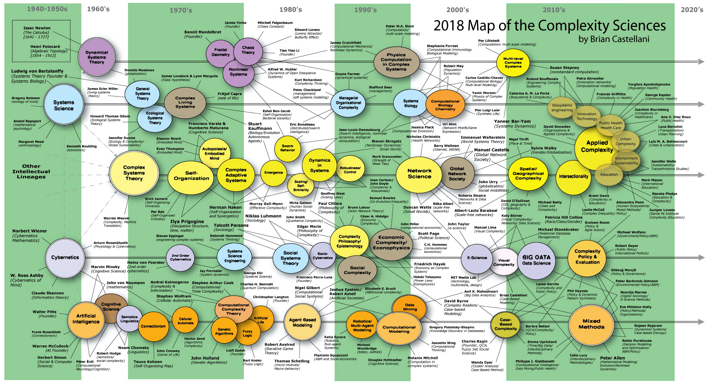
Notes:
How about this one!?...

